Slide 1
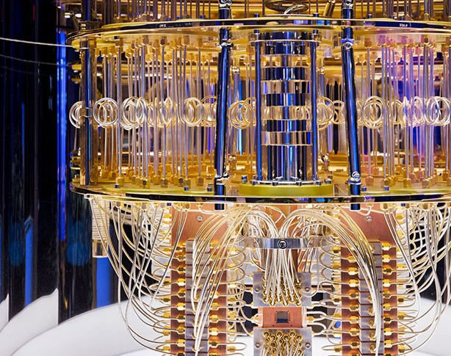
Quantum Computing The Race for Global Supremacy
James Kroll
Computer Science & Information Systems
Senior Capstone Seminar
Spring 2022
Photo Provided by: IBM, 2021

Slide 2
Definitions
Quantum Mechanics – a theory of matter that is based on the concept of the possession of wave properties by elementary particles, that affords a mathematical interpretation of the structure and interactions of matter on the basis of these properties, and that incorporates within it quantum theory and the uncertainty principle
Quantum Theory – a theory in physics based on the concept of the subdivision of radiant energy into finite quanta and applied to numerous processes involving transference or transformation of energy in an atomic or molecular scale
Uncertainty Principle - a principle in quantum mechanics: it is impossible to discern simultaneously and with high accuracy both the position and the momentum of a particle (such as an electron)
Quantum Entanglement – a property of a set of subatomic particles whereby a quantum characteristic (such as spin or momentum) of one particle is directly and immediately correlated with the equivalent characteristic of the others regardless of separation in space
Qubit - a unit of computing information that is represented by a state of an atom or elementary particle (such as the spin) and can store multiple values at once due to the principles of quantum mechanics. Figure 2 provides a visually depiction of classical bit vs qubit.
Quantum Computing - a computer that takes advantage of the quantum properties of qubits to perform certain types of calculation extremely quickly compared to conventional computers
All definitions have been obtained from Merriam-Webster.com

Slide 3
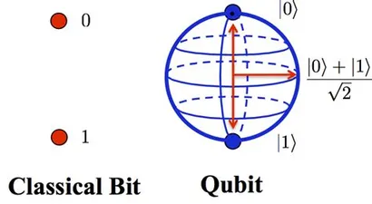
Figure 2
Image provided by: IEEE Explore journal article

Slide 4
Hardware
Quantum Computing requires specific hardware in a controlled environment in order to operate effectively.
Current technology allows quantum components in isolation to work in tandem with classical computers to complete its computations, as illustrated in figure 3.
Quantum Reversible Gate – a gate that allows the input to be manipulated, based on observing the output because quantum operations are unitary in design.
Quantum Register – a designated set of qubits that holds all the possible combinations, based on input. An n-qubit register hold 2^n possible combinations simultaneously
Quantum Processing Unit – working on the properties of quantum mechanics, it requires RAM (Logic Gates + Register), a quantum control unit, and quantum transistors. The QPU sends its data back through the control unit which communicates with the classical computer, and eventually the end user.
All quantum components are housed in a vacuum sealed and typically refrigerated environment.
Most research is conducted at 1 K, this is required to stabilize and maintain the coherence of the qubits.
Recent research has discovered qubit coherence in a room temperature environment.

Slide 5
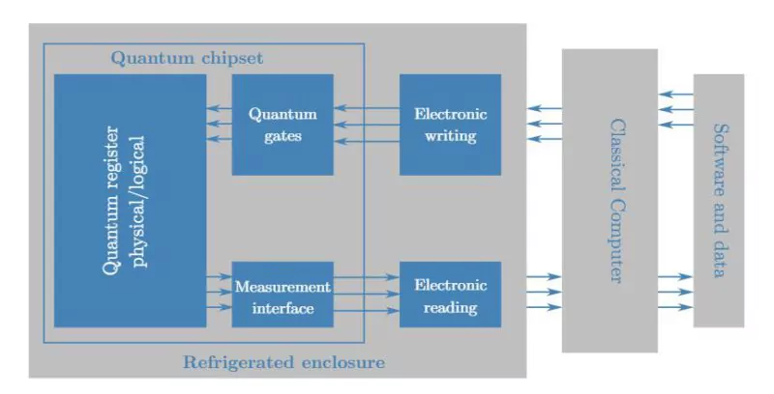
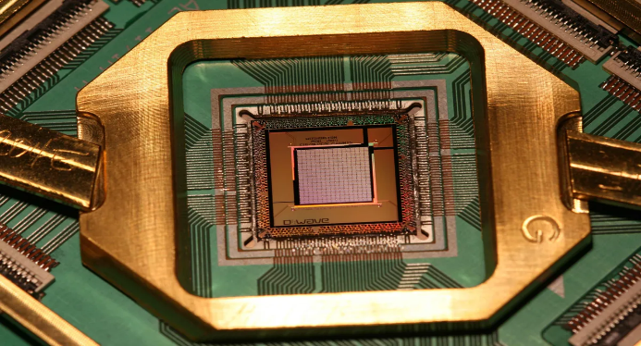
Figures 3 & 4
Figure 4: Depicts Google & D-Wave’s quantum processor.
Photo Provided by: (Quantum Processor, n.d.)
Figure 3: Depicts the interaction between quantum computing components and classical computers.
Photo Provided by: IEEE Explore journal article

Slide 6
Modern Approaches
Photonics – uses individual photons to transmit information. Having a weak interaction with the environment around them, photons exhibit a natural isolation property. Their weak interactions allows for accurate qubit representation while in a room temperature environment. Has the advantage of compatible integration with fiber optic-based infrastructure.
Trapped Ions – the process requiring a steel vacuum chamber cooled down to 1K, or nearly -450 F, using multiple lasers to chip individual electrons away from the atom, ionizing it. Electrodes are used to generate an electric field that captures those ions.
Semiconducting Material - a process that simulates electrons in materials such as germanium, diamonds, selenium, or silicon carbide. Through the application of microwaves and magnetic fields, the materials begin to exhibit quantum properties, including superposition and entanglement. Operating near 0.1 K, semiconducting material made strides in 2020, when they achieved coherent results at 1.5 K
Superconducting Material – a process that uses microwaves along with low-frequency electrical signals. The signals are transmitted through wires and supercooled before reaching the qubits in the controlled environment.
All descriptions have been obtained from (Hajjar, 2022a)

Slide 7
Benefits
The ability to crunch massive amounts of data. CERN outputs 1 petabyte of data per second while in operation. CERN has partnered with IBM and joined their quantum network, boasting a fleet of 23 quantum machines. Previously it required nearly 1 million CPUs at 170 locations around the world.
The simulation capabilities of a quantum computer will be able to advance our knowledge about the origin of the universe while mapping out the known universe, advance nuclear fusion research, further climate change research, expedite drug and vaccine trials, and it could be the secret to unlocking AI consciousness.
Additionally, it is theorized that quantum simulations may remove the need altogether for physical lab testing in many industries as it could replicate the experiment thousands of times much faster than we could finish a single trial.
Had we lived in a quantum computing age during the COVID-19 pandemic, a vaccine could have been developed in a matter of days, which may have drastically changed the landscape of that time.
Network security becomes a lot harder to crack with quantum encryption. Some companies and governments have been exploring upgrading to quantum encryption. It is theorized that a hacker using quantum components would break the public key encryption system we rely on so heavily today.

Slide 8
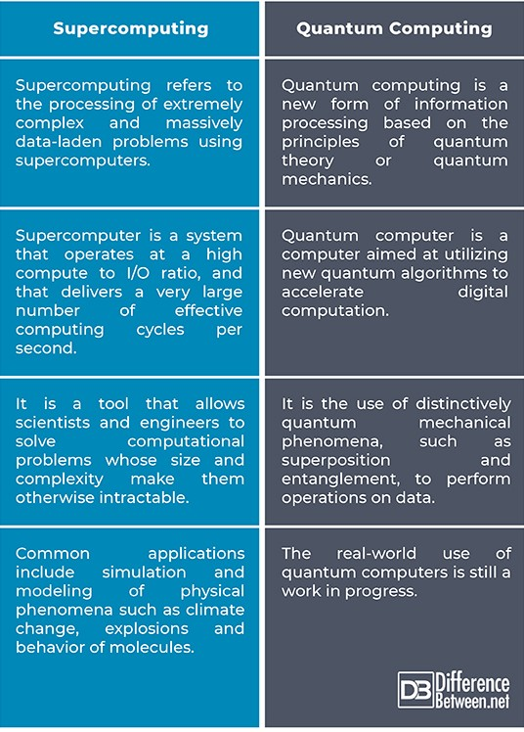
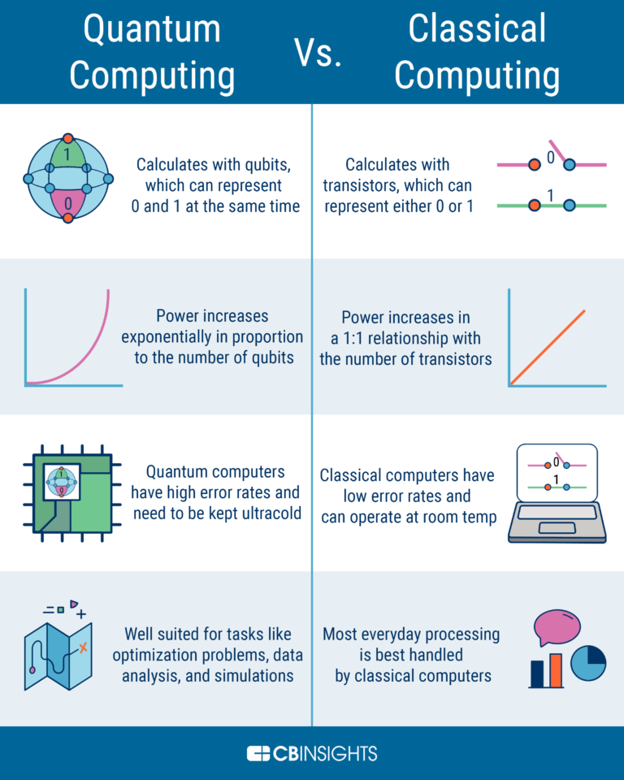
Quantum vs Super vs Classical Computers
Figure 5: Chart depicting the differences between supercomputers and quantum computers.
Photo Provided by: Supercomputing vs Quantum Computing, 2021)
Figure 6: depicting the benefits and challenges of quantum computers vs classical (digital) computers.
Photo Provided by:(Quantum Computing vs Digital Computing, 2021

Slide 9
Challenges
We have only entered the toddler phase of Quantum research and although research teams are making discoveries at a rate unheard of 20 years ago, a lot of those discoveries are hard to repeat, some of which only experiencing a 1/10 rate of consistency. Although that is amazing in terms of conceptual understanding, it means we are far from implementing these discoveries into everyday life.
The current operational climate for quantum computers is not ideal. Photonics gave us a breakthrough that will help make quantum research more operational.
The cost for current research/discovery ratio is extremely high.
Similar to fusion with the idea that “true quantum computing” is still decades off.
Quantum computers are currently highly specialized to the desires of each research goal. A lot of the discoveries from one team’s machine are difficult to replicate for other teams on their own machines.
Although this has gotten better since the Quantum Initiative was signed, a lack of funding will always be a detriment to research.
Most countries still do not possess their own infrastructure which causes delays in their research.

Slide 10
Quantum Initiative
In 2018 the United States government signed into law the National Quantum Initiative Act, establishing the goals and funding for a 10-year plan.
In 2017 China began construction on their national laboratory, which later created the Jiuzhang prototype quantum computer. In their 14th 5-year plan (2021-2025), China has agreed to dedicate $10 billion towards gaining quantum supremacy.
In 2021 Germany announced its plan to help fund quantum research. With nearly $3 billion in funding over time, Germany plans to build its own quantum infrastructure.
In 2021 France signed legislation for a 5-year $2.2 billion round of funding for quantum research.
In 2019 U.K. announced its second round of quantum research funding (2019-2025), totaling more than $1.3 billion over the term. This is an increase of 5-fold, from its previous round of funding in 2013.
In 2016 the European Union first announced its plans for future funding in quantum technologies. The declaration was signed by its members in 2019. The funding totals more than $1 billion.
In 2020 India released the Quantum computer simulator toolkit, QSim, providing their quantum research with global recognition. Without having any infrastructure built locally, India is racing to catch up and has dedicated over $1 billion to construct the required infrastructure.

Slide 11
Quantum Initiative continued
Canada is home to D-Wave systems, the first company to provide enterprise solutions in quantum computing, has invested nearly $1 billion into quantum research and continues to remain a top competitor.
In 2021 Russia managed to build its first 4-qubit quantum computer. This milestone allows them to achieve independence with their research. They have invested around $750 million towards that end.
Japan has partnered with IBM and Tokyo Universities quantum research teams. With over $500 million in funding, they are making strides towards becoming a major player.
Israel made history with their quantum research earlier this year as they completed their first quantum computer. This milestone will help secure further funding towards their quantum future, adding to the $350 million already invested.
Taiwan has invested nearly $300 million into building their own infrastructure and hope to have in completed by 2024.
The Netherlands remain competitive in quantum research even with their lack of total investment. Home to Qtech and the centre of quantum technology and computing in Delft, they remain a top player in the EU’s quantum efforts. To date the Netherlands has invested under $200 million.

Slide 12
Quantum Initiative continued
Austria has invested over $125 million and announced in February 2022 that quantum cybersecurity firm ID Quantique will be locating its center of competence in Austria.
Singapore has invested over $100 million and announced in February 2022 their plan to develop a quantum network that will demonstrate “crypto-agile-connectivity”. They plan to offer this service to public and private sectors.
Australia is approaching the $100 million mark and has already announced plans to increase that funding as they plan to create thousands of jobs and help integrate quantum technologies into their commercial space.
Korea, with less than $50 million invested in aiming to integrate quantum cryptography into their commercial companies.
New Zealand, having invested around $40 million so far has announced their plans to increase that funding over the next 7 years assisting the research at Dodd-Walls centre for Photonic and Quantum Technologies.

Slide 13
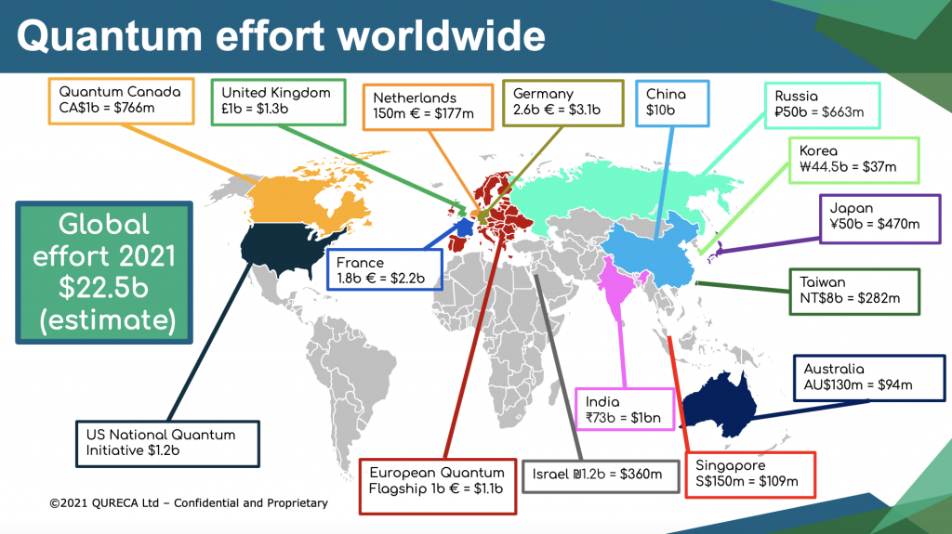
Figure 7: depicting the global investment into quantum research by country.
Photo Provided by: Qureca Ltd - 2021

Slide 14
History Pre-dating Quantum Computers
1900 – Max Plank, who is considered the father of quantum mechanics, introduces the scientific community to the word “quantum”, derived from the Latin definition “minimum amount of a quantity which can exist”. Plank went on to develop quantum theory after observing the effect of radiation on a substance he calls “blackbody”.
1905 – Albert Einstein explains photoelectric effect’s ability to release electron from material by shining light on it.
1920’s – Max Born, Werner Heisenberg, and Wolfgang Pauli coined “quantum mechanics”, and in 1924 Born published a study using the term for the first time.
1925 – Heisenberg, Born, and Pascual Jordan formulate matrix mechanics.
1927- John Von Neumann publishes the framework for quantum statistics.
Late 1920’s - Heisenberg and Niels Bohr develop Heisenberg’s Uncertainty Principle.
1930 – Paul Dirac publishes the first textbook on quantum mechanics “The Principles of Quantum Mechanics” which is still used as a reference today.
1935 – Erwin Schrödinger, after discussing superposition with Einstein, develops his famous thought experiment, Schrödinger’s Cat. Through this experiment, Schrödinger theorized quantum entanglement.
1947 – Einstein dismissed quantum entanglement in a letter to Max Born, referring to it as “spooky action at a distance”.

Slide 15
Early Quantum Computing
1976 – Polish Physicist Roman Ingarden published the first attempt at creating quantum theory.
1980 – Paul Benioff publishes “The computer as a physical system: A microscopic quantum mechanical Hamiltonian model of computers as represented by Turing machines”. In the study Benioff demonstrates how a computer could operate within quantum mechanics, using a Schrödinger equation definition of a Turing machine.
1981 – Richard P. Feynman at a keynote speech theorized how physics could properly be simulated using a quantum computer and argued how it’s impossible to properly simulate on a classical computer. He is quoted as stating “nature isn't classical, dammit, and if you want to make a simulation of nature, you'd better make it quantum mechanical.”
1985 – David Deutsch publishes a description of a quantum Turing machine.
1992 – The Deutsch-Joza algorithm is published and is the first example of a quantum algorithm that operates exponentially faster than the capabilities of classical computing.
1993 – Physicist Charles Bennet alongside a team of colleagues published an article titled “Teleporting an unknown quantum state via dual classical and Einstein-Podolsky-Rosen channels”. The report describes in detail how quantum teleportation could work using mathematical models.

Slide 16
Early Quantum Computing Continued
1994 – Peter Shor of Bell Laboratories develops a quantum algorithm for factoring integers that possess the capabilities to decrypt RSA-encrypted communications.
1994 – The National Institute of Standards and Technology organizes a quantum computing conference sponsored by the US government, signaling a shift in our government’s confidence toward quantum research.
1996 – Lov Grover of Bell Laboratories publishes Grover’s algorithm, a quantum database search algorithm that is still being taught today.
1998 – MIT team of researchers publish “Experimental Quantum Error Correction”. The report describes the implementation of quantum error correcting code which compensates for “small phase errors due to fluctuations in the local magnetic field”.
1998 – Isaac Chuang, Neil Gershenfeld, and Mark Kubinec create the first 2-qubit quantum computer, able of processing input and producing an output. This experiment was a success for mere nano-seconds, but it demonstrated the principles of quantum computing on a physical device.
1999 – Yasunobu Nakamura working for RIKEN’s quantum research group, demonstrates that qubits can also be made on superconducting circuits through the application of what he describes as a “sharp voltage pulse to the pulse gate”. Nakamura was able to control energy levels and manipulate the quantum state in a single-pair-cooper box.
2002 – For the first time in history we have a published Quantum Roadmap. This was developed by a panel of researchers across the country’s most advanced research groups and was annually updated through 2009. This kicks off the modern age of quantum research.

Slide 17
Modern Research
2014 – Researchers at Delft successfully teleport information between 2 qubits, separated by 10 feet, with a 0% error rate.
2018 – CERN’s openlab joins with IBM’s quantum network fleet of 23 machines, replacing 1 million CPUs at 170 locations worldwide. CERN produces 1 Petabyte of data per second while in operation.
2019 – University of Glasgow provides the world with first photographic proof of quantum entanglement.
2019 – Google releases the first 100+ qubit quantum computer.
2021- That same quantum computer creates a quantized time crystal: a qubit that can cycle between states without consuming any energy.
2021 – World’s first multinode quantum network goes online. 3-node network from a team at QuTech in the Netherlands.
January 2022 – ColdQuanta and Classiq announce a partnership combining classiq’s 100-qubit quantum algorithms with ColdQuanta’s Hilbert Quantum Computer.
February 2022 – Team at QuTech creates a time crystal based on spins in diamond. Using 9 qubits they manipulated them until they satisfied the requirements for a time crystal.
February 2022 – A team led by IonQ, containing collegiate researchers from all over, create a new quantum logic gate based on trapped ion qubits via spin-dependent squeezing.
March 2022 – NASA and Germany’s DLR announce a partnership to develop open-source software for quantum computers with aerospace applications.

Slide 18
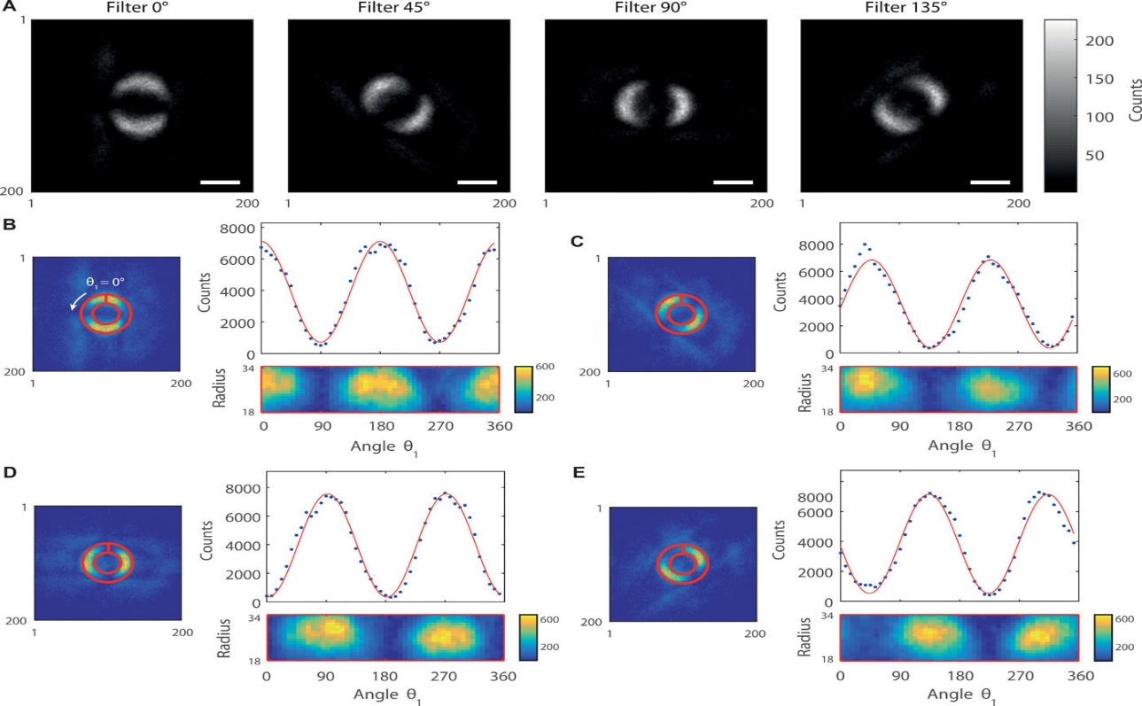
Figure 8: depicting the quantum entanglement captured by the University of Glasgow, 2019.
Photo Provided by: University of Glasgow, 2019

Slide 19
Commercialization
In 2011 Canadian based company D-Wave became the first to offer commercial quantum products. It sold for $10 million to a Company in Maryland. The machine would use quantum annealing, a process of optimization in terms of minimalizing the required energy input, before collapsing into a 1 or 0.
IBM Quantum System One, boasting a user base of 400k provides cloud quantum computing resources for enterprise use. IBM has also partnered with CERN for massive data analysis of the Large Hadron Collider experiments.
Microsoft’s Azure Quantum is a collaborative initiative allowing companies access to a range of quantum resources across the world. There are currently 9 companies offering quantum technologies accessible through Azure.
Google offers access to its Quantum AI for approved research groups in need of high-powered simulations. Offered to the public is their opensource software, Cirq which allows the user to experiment with intermediate scale quantum algorithms.

Slide 20
Final Thoughts
The benefits of quantum computing far outweigh any risks associated with bad actors.
Quantum simulations can accelerate research in every field thus advancing human society in all areas.
We are at a point in research where the advancements are happening at an exponential rate and because of that, the quantum future is one that we may get to experience in our lifetimes

